Slide 1

Programming in Python
Dr Malu G
Kerala University of Digital Sciences, Innovation and Technology

Slide 2
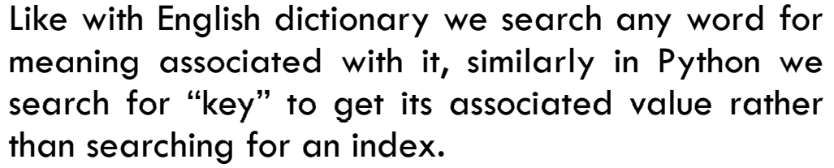
Dictionary
The data type dictionary falls under mapping
It is a mapping between a set of keys and a set of values.
The key-value pair is called an item.
A key is separated from its value by a colon(:) and consecutive items are separated by commas.
Items in dictionaries are unordered, so we may not get back the data in the same order in which we had entered the data initially in the dictionary.

Slide 3
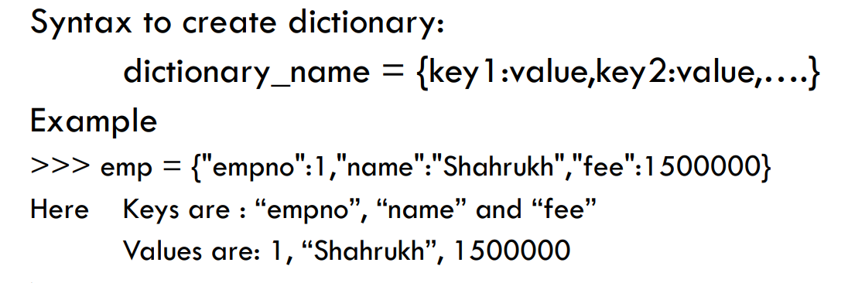
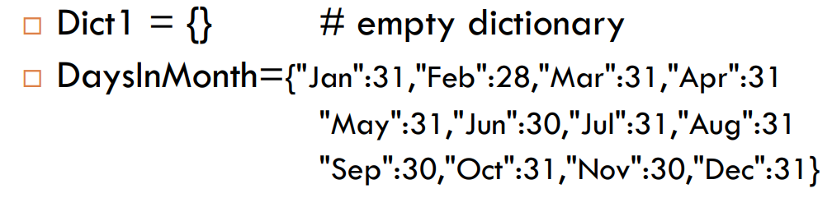
Creating a Dictionary

Slide 4
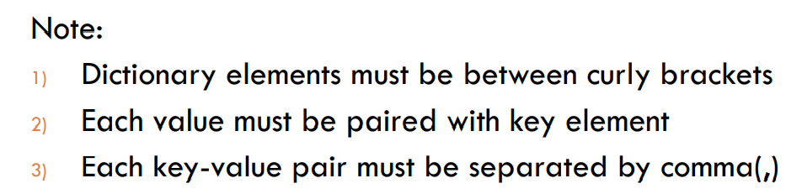
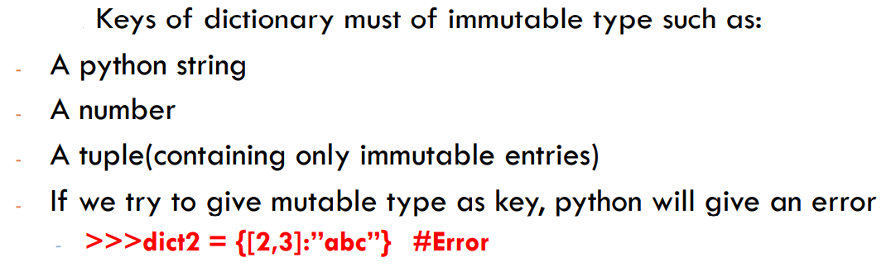
Creating a Dictionary
4)

Slide 5
Creating a Dictionary
To create a dictionary, the items entered are separated by commas and enclosed in curly braces.
Each item is a key value pair, separated through colon (:).
The keys in the dictionary must be unique and should be of any immutable data type i.e. number, string or tuple.
The values can be repeated and can be of any data type.

Slide 6
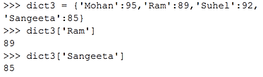
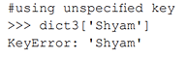
Accessing Items in a Dictionary
The items of a dictionary are accessed via the keys rather than via their relative positions or indices.
Each key serves as the index and maps to a value.
If the key is not present in the dictionary we get KeyError.
In the example, the key 'Ram' always maps to the value 89 and key 'Sangeeta' always maps to the value 85. So the order of items does not matter.

Slide 7
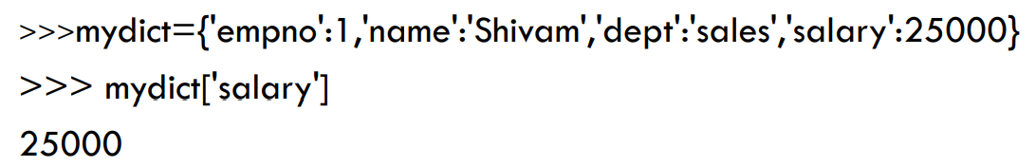
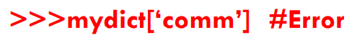
Accessing Items in a Dictionary

Slide 8
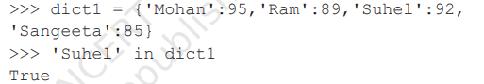
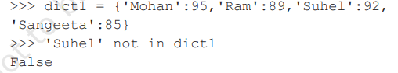
Membership Operation
The membership operator in checks if the key is present in the dictionary and returns True, else it returns False.
The not in operator returns True if the key is not present in the dictionary, else it returns False.

Slide 9
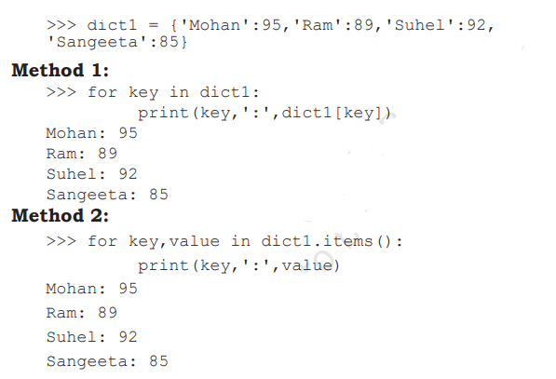
Traversing a Dictionary
We can access each item of the dictionary or traverse a dictionary using for loop.

Slide 10
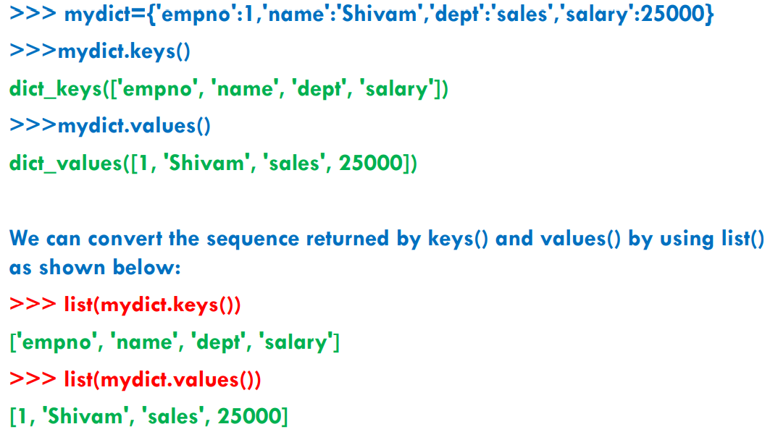

Slide 11
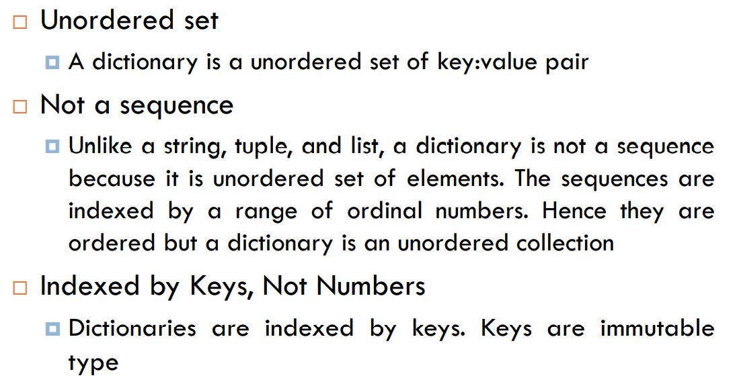

Slide 12
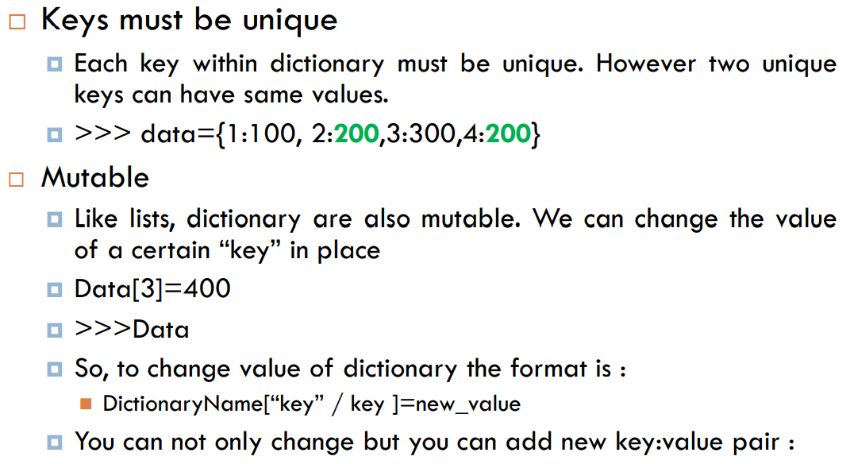
DictionaryName[“new key”]= value

Slide 13
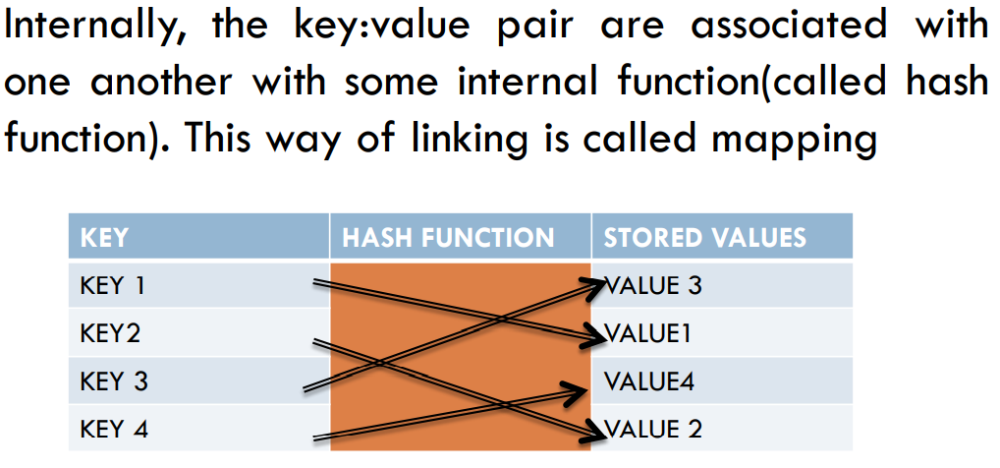
Internal working of Dictionary

Slide 14
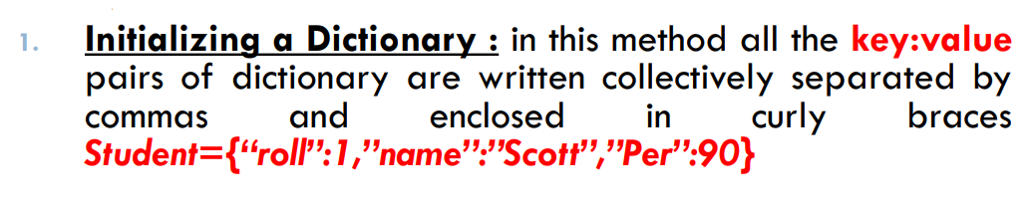
Manipulating Dictionaries

Slide 15
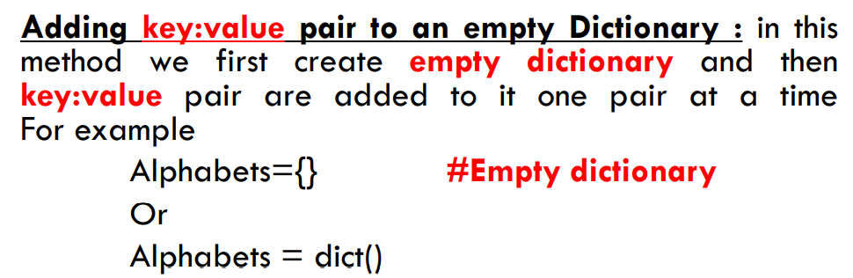
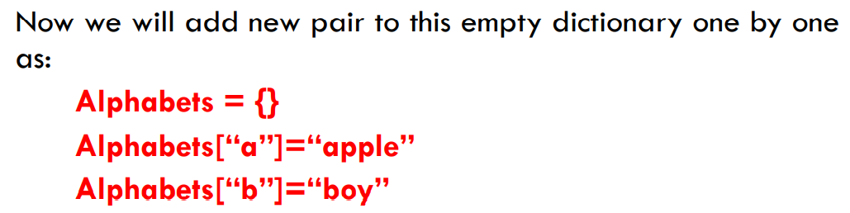
Multiple Ways of Creating Dictionaries
2.
>>>Alphabets
{‘a’: ‘apple’, ‘b’: ‘boy’}

Slide 16
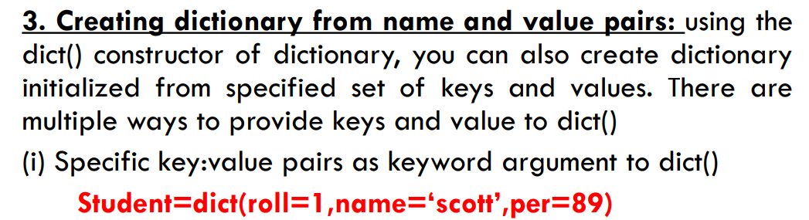
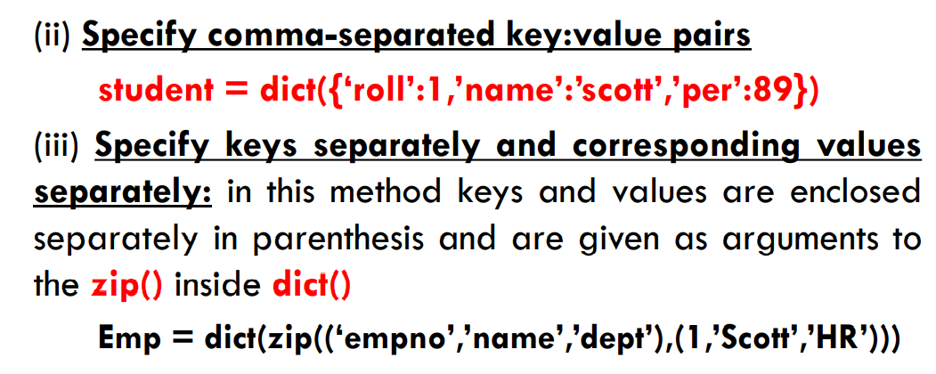
Multiple Ways of Creating Dictionaries

Slide 17
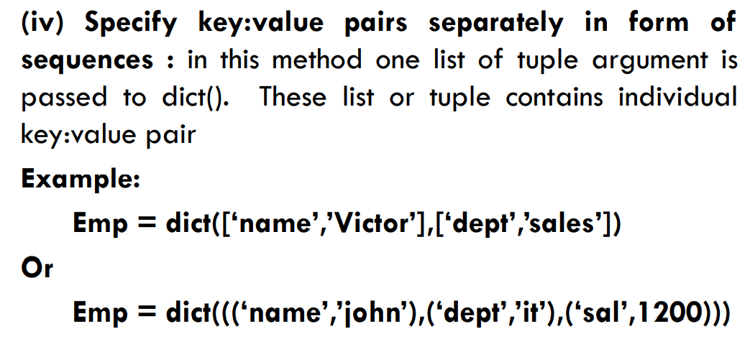
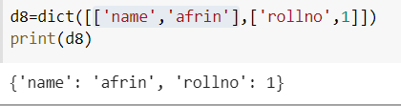
Multiple Ways of Creating Dictionaries

Slide 18
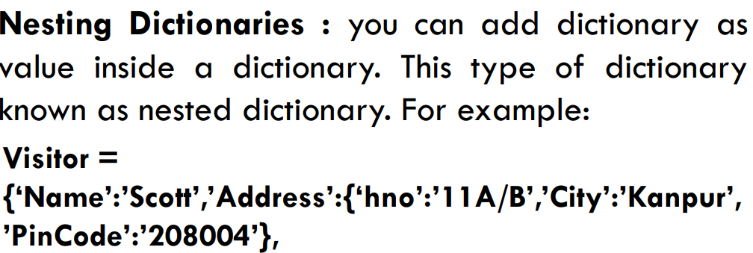
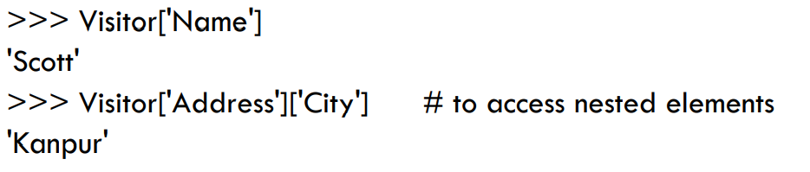
Multiple Ways of Creating Dictionaries

Slide 19
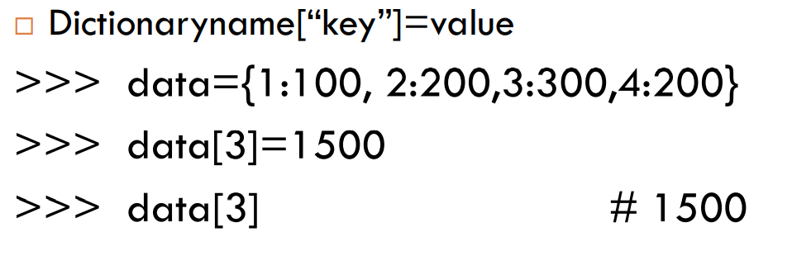

Slide 20
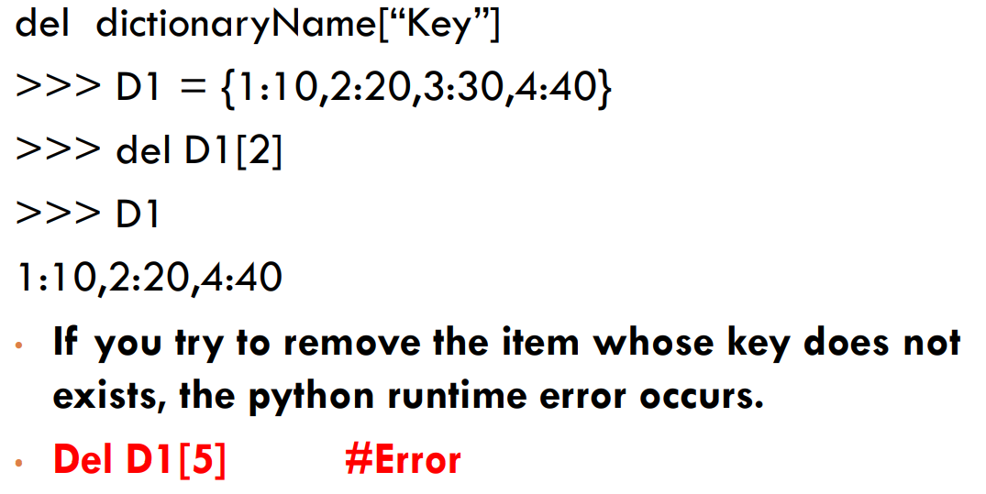
{1: 10, 3: 20, 4: 40}

Slide 21

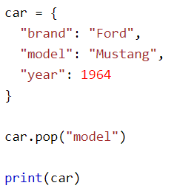
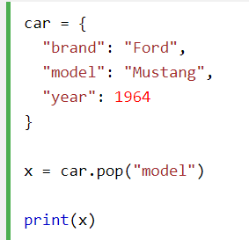
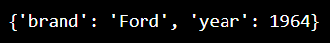
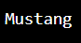
The pop() method removes the specified item from the dictionary.
Note: The value of the removed item is the return value of the pop() method .

Slide 22

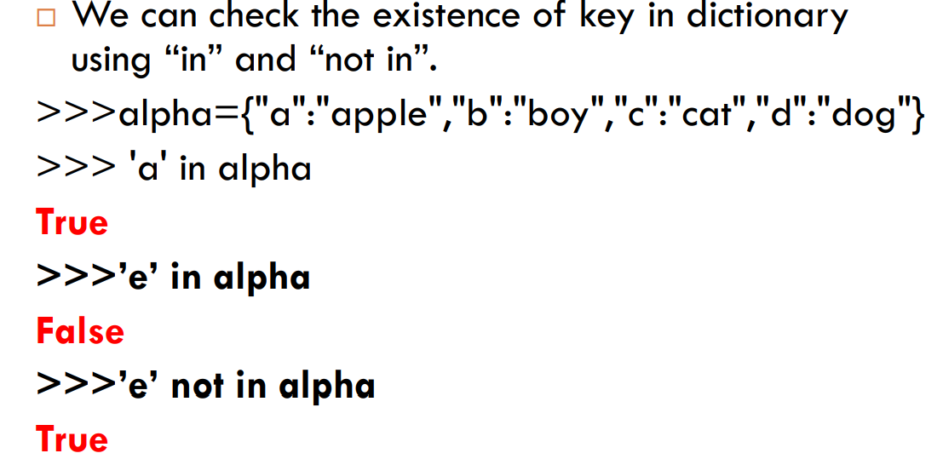

Slide 23
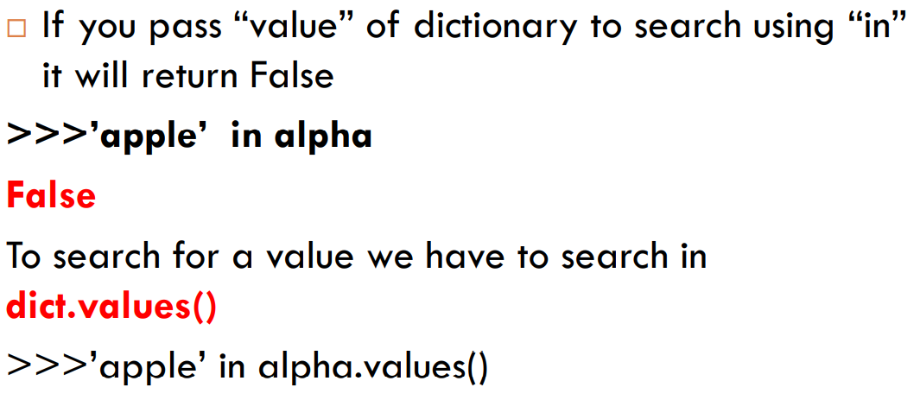

Slide 24

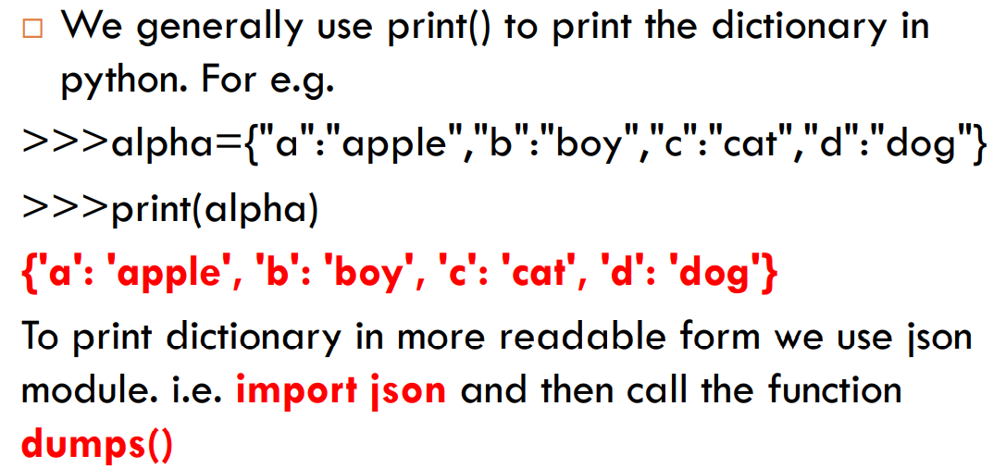
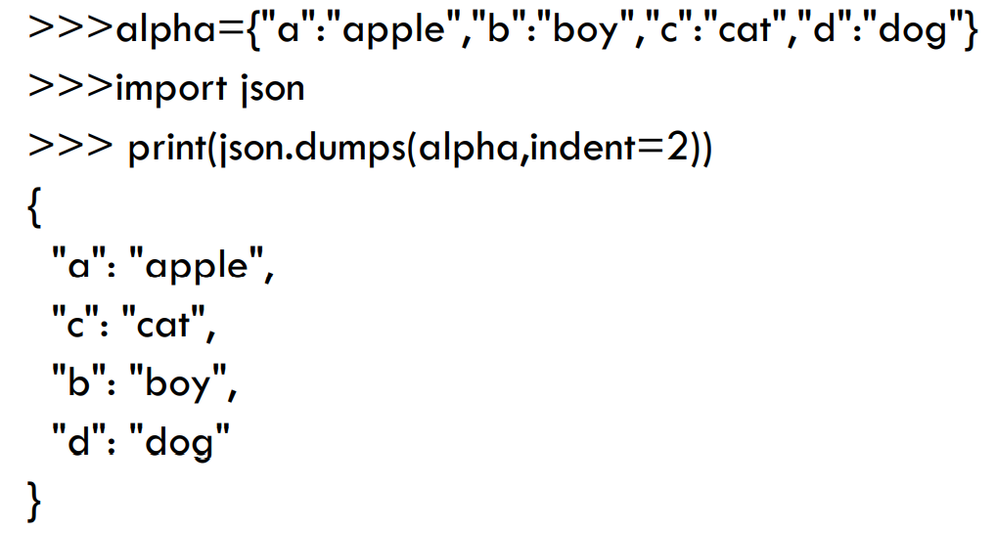

Slide 25
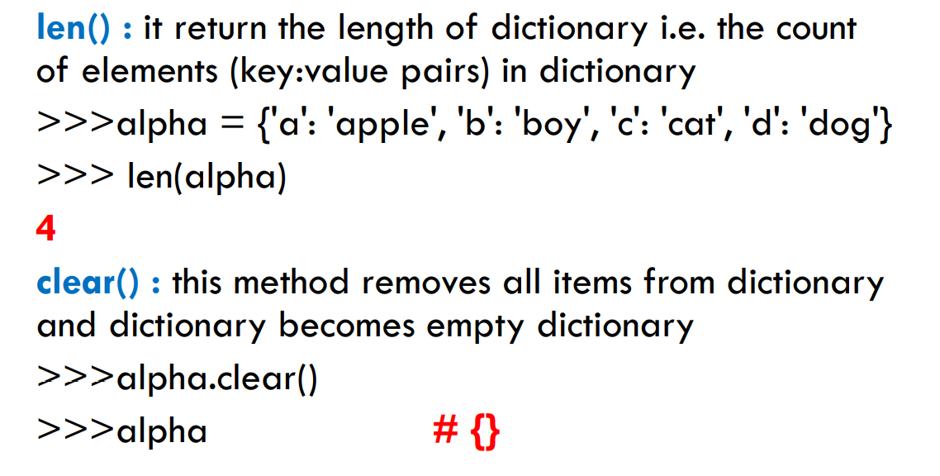
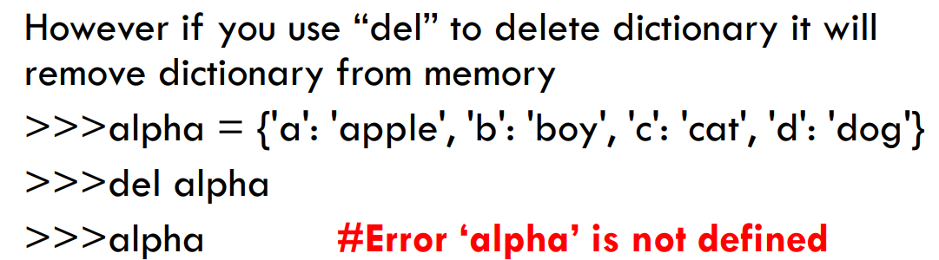

Slide 26
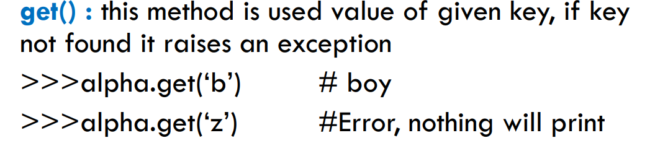
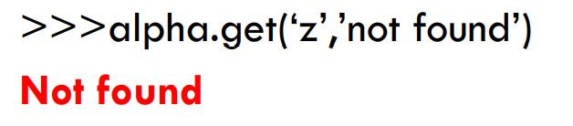

Slide 27
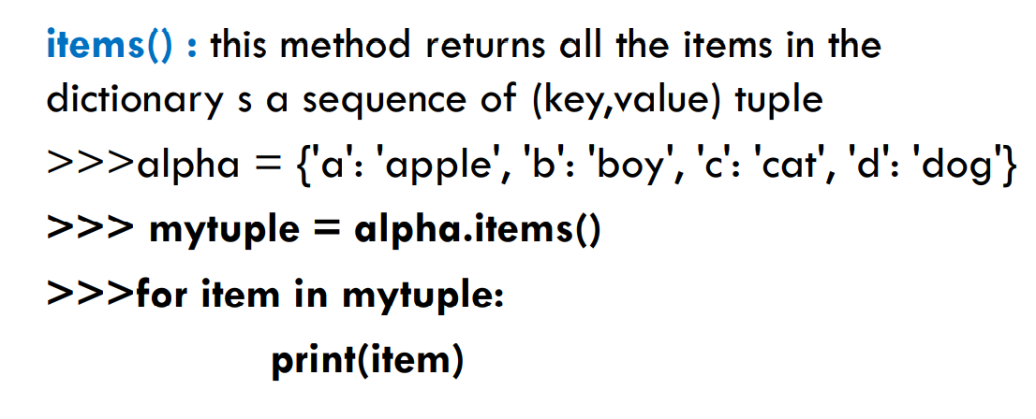
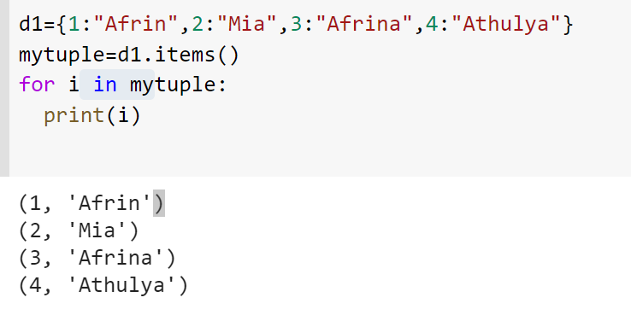
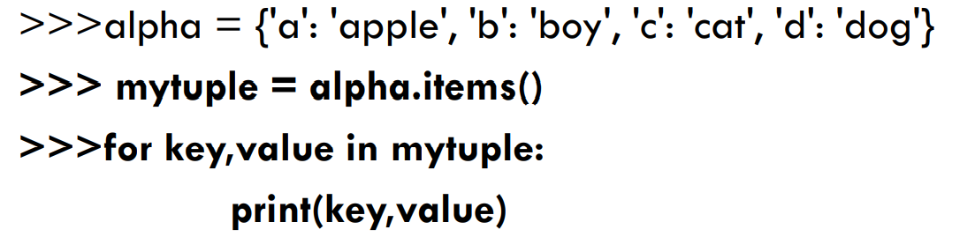

Slide 28
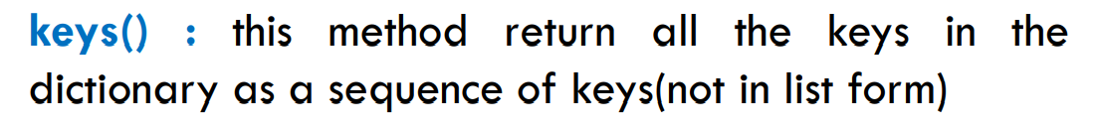
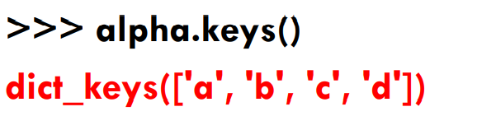
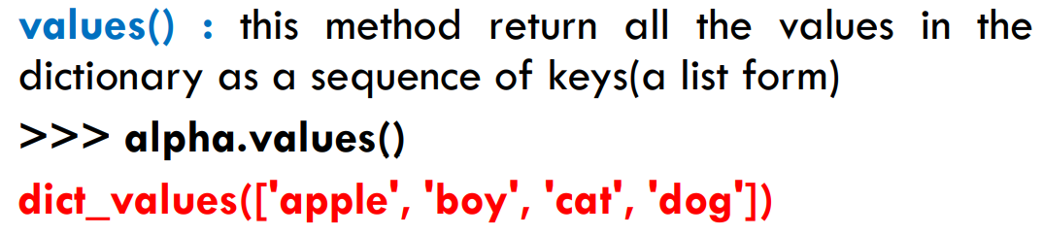

Slide 29

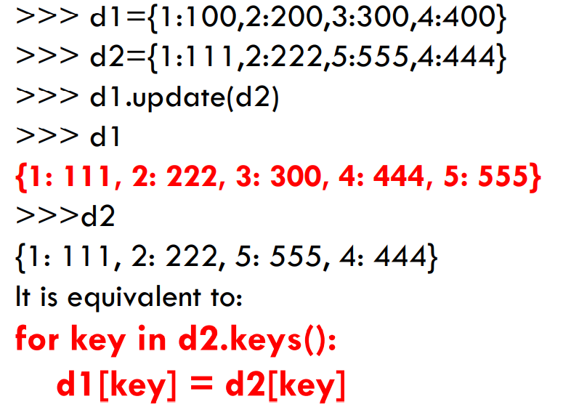
appends the key-value pair of the dictionary passed as the argument to the key-value pair of the given dictionary.

Slide 30
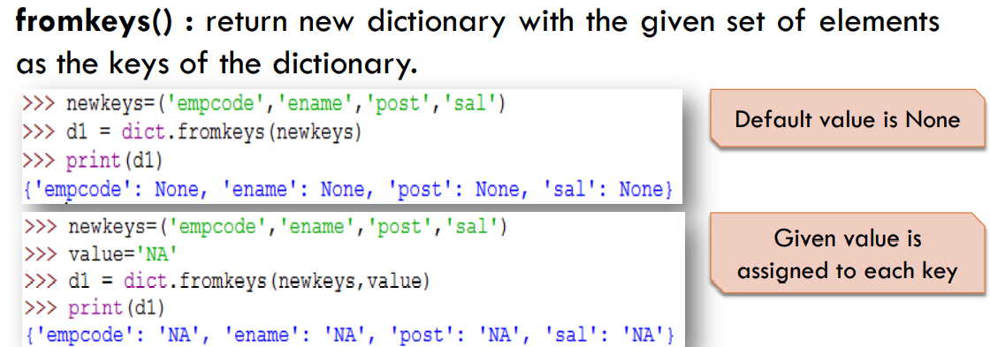
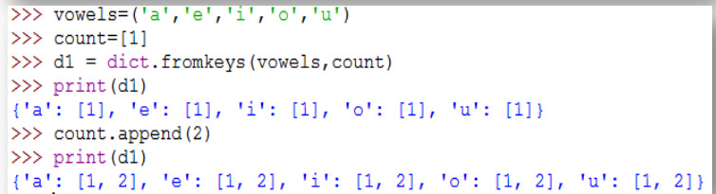
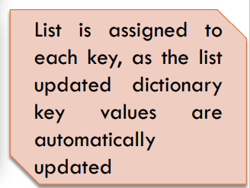

Slide 31
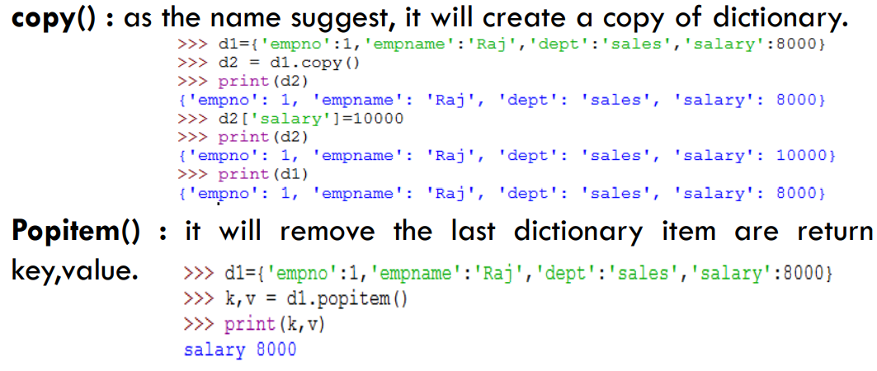

Slide 32



Slide 33



Slide 34



Slide 35


Slide 37
Strings
Strings are amongst the most popular types in Python.
We can create them simply by enclosing characters in quotes. Python treats single quotes the same as double quotes.
Creating strings is as simple as assigning a value to a variable. For example:
var1 = 'Hello World!'
var2 = "Python Programming"

Slide 38
Accessing Values in Strings:
Python does not support a character type; these are treated as strings of length one, thus also considered a substring.
To access substrings, use the square brackets for slicing along with the index or indices to obtain your substring:
Example:
var 1 = 'Hello World!'
var2 = "Python Programming"
print "var1[0]: ", var1[0]
print "var2[1:5]: ", var2[1:5]
This will produce following result:
var1[0]: H
var2[1:5]: ytho

Slide 39
Updating Strings:
You can "update" an existing string by (re)assigning a variable to another string.
The new value can be related to its previous value or to a completely different string altogether.
Example:
var1 = 'Hello World!'
print "Updated String :- ", var1[:6] + 'Python'
This will produce following result:
Updated String :- Hello Python

Slide 40
String Special Operators: Assume string variable a holds 'Hello' and variable b holds 'Python' then:
Operator | Description | Example
+ | Concatenation - Adds values on either side of the operator | a + b will give HelloPython
* | Repetition - Creates new strings, concatenating multiple copies of the same string | a*2 will give -HelloHello
[] | Slice - Gives the character from the given index | a[1] will give e
[ : ] | Range Slice - Gives the characters from the given range | a[1:4] will give ell
in | Membership - Returns true if a character exists in the given string | H in a will give 1
not in | Membership - Returns true if a character does not exist in the given string | M not in a will give 1
r/R | Raw String - Suppress actual meaning of Escape characters. | print r'\n' prints \n and print R'\n' prints \n
% | Format - Performs String formatting | See at next section

Slide 41
String Formatting with % Operator:
Format Symbol | Conversion
%c | character
%s | string conversion via str() prior to formatting
%i | signed decimal integer
%d | signed decimal integer
%u | unsigned decimal integer
%o | octal integer
%x | hexadecimal integer (lowercase letters)
%X | hexadecimal integer (UPPERcase letters)
%e | exponential notation (with lowercase 'e')
%E | exponential notation (with UPPERcase 'E')
%f | floating point real number
%g | the shorter of %f and %e
%G | the shorter of %f and %E

Slide 42
String Formatting with % Operator:
# Python program to demonstrate the use of formatting using %
# Initialize variable as a string
variable = '15'
string = "Variable as string = %s" %(variable)
print (string )
# Printing as raw data
print ("Variable as raw data = %r" %(variable))
# Convert the variable to integer
# And perform check other formatting options
variable = int(variable) # Without this the below statement
# will give error.
string = "Variable as integer = %d" %(variable)
print (string)
print ("Variable as float = %f" %(variable))
# printing as any string or char after a mark
print ("Variable as printing with special char = %c" %(variable))
print ("Variable as hexadecimal = %x" %(variable))
print ("Variable as octal = %o" %(variable))
Variable as string = 15
Variable as raw data = '15'
Variable as integer = 15
Variable as float = 15.000000
Variable as printing with special char = mayank
Variable as hexadecimal = f
Variable as octal = 17

Slide 43
Other supported symbols and functionality are listed in the following table:
Symbol | Functionality
* | argument specifies width or precision
- | left justification
+ | display the sign
<sp> | leave a blank space before a positive number
# | add the octal leading zero ( '0' ) or hexadecimal leading '0x' or '0X', depending on whether 'x' or 'X' were used.
0 | pad from left with zeros (instead of spaces)
% | '%%' leaves you with a single literal '%'
(var) | mapping variable (dictionary arguments)
m.n. | m is the minimum total width and n is the number of digits to display after the decimal point (if appl.)

Slide 44
Triple Quotes:
Python's triple quotes comes to the rescue by allowing strings to span multiple lines, including verbatim NEWLINEs, TABs, and any other special characters.
The syntax for triple quotes consists of three consecutive single or double quotes.
para_str = """this is a long string that is made up of several lines and non-printable characters such as TAB ( \t ) and they will show up that way when displayed.
NEWLINEs within the string, whether explicitly given like this within the brackets [ \n ], or just a NEWLINE within the variable assignment will also show up. """
print para_str;

Slide 45
Raw String:
Raw strings don't treat the backslash as a special character at all. Every character you put into a raw string stays the way you wrote it:
print 'C:\\nowhere'
This would print following result:
C:\nowhere
Now let's make use of raw string. We would put expression in r'expression' as follows:
print r'C:\\nowhere'
This would print following result:
C:\\nowhere

Slide 46
Unicode String:
Normal strings in Python are stored internally as 8-bit ASCII, while Unicode strings are stored as 16-bit Unicode.
This allows for a more varied set of characters, including special characters from most languages in the world.
print u'Hello, world!'
This would print following result:
Hello, world!
Notes:
an international encoding standard for use with different languages and scripts, by which each letter, digit, or symbol is assigned a unique numeric value that applies across different platforms and programs.

Slide 47
Built-in String Methods:
1 | capitalize()
 | Capitalizes first letter of string
2 | center(width, fillchar)
 | Returns a space-padded string with the original string centered to a total of width columns
3 | count(str, beg= 0,end=len(string))
 | Counts how many times str occurs in string, or in a substring of string if starting index beg and ending index end are given
3 | decode(encoding='UTF-8',errors='strict')
 | Decodes the string using the codec registered for encoding. encoding defaults to the default string encoding.
4 | encode(encoding='UTF-8',errors='strict')
 | Returns encoded string version of string; on error, default is to raise a ValueError unless errors is given with 'ignore' or 'replace'.

Slide 48
Built-in String Methods:
5 | endswith(suffix, beg=0, end=len(string))
 | Determines if string or a substring of string (if starting index beg and ending index end are given) ends with suffix; Returns true if so, and false otherwise
6 | expandtabs(tabsize=8)
 | Expands tabs in string to multiple spaces; defaults to 8 spaces per tab if tabsize not provided
7 | find(str, beg=0 end=len(string))
 | Determine if str occurs in string, or in a substring of string if starting index beg and ending index end are given; returns index if found and -1 otherwise
8 | index(str, beg=0, end=len(string))
 | Same as find(), but raises an exception if str not found

Slide 49
Built-in String Methods:
9 | isa1num()
 | Returns true if string has at least 1 character and all characters are alphanumeric and false otherwise
10 | isalpha()
 | Returns true if string has at least 1 character and all characters are alphabetic and false otherwise
11 | isdigit()
 | Returns true if string contains only digits and false otherwise
12 | islower()
 | Returns true if string has at least 1 cased character and all cased characters are in lowercase and false otherwise
13 | isnumeric()
 | Returns true if a unicode string contains only numeric characters and false otherwise
14 | isspace()
 | Returns true if string contains only whitespace characters and false otherwise

Slide 50
Built-in String Methods:
15 | istitle()
 | Returns true if string is properly "titlecased" and false otherwise
16 | isupper()
 | Returns true if string has at least one cased character and all cased characters are in uppercase and false otherwise
17 | join(seq)
 | Merges (concatenates) the string representations of elements in sequence seq into a string, with separator string
18 | len(string)
 | Returns the length of the string
19 | ljust(width[, fillchar])
 | Returns a space-padded string with the original string left-justified to a total of width columns
20 | lower()
 | Converts all uppercase letters in string to lowercase

Slide 51
Joining with an empty string
# Joining with empty separator
list1 = [‘K’, ‘U’, ‘D’, ‘S’, ‘I’,’T’]
print("".join(list1))
# Joining with string
list1 = " KUDSIT"
print(“@".join(list1))
Output:
KUDSIT
geeks K@U@D@S@I@T

Slide 52
Joining String with lists using join()
# elements in tuples list1 = ('1', '2', '3', '4') # put any characher to join s = "-" # joins elements of list1 by '-' # and stores in string s s = s.join(list1) # join use to join a list of # strings to a separator s print(s)
Here, we join the tuples of elements using the join() method in which we can put any character to join with a string.
Python3
Output:
1-2-3-4

Slide 53
Joining String with sets using join()
In this example, we are using a Python set to join the string.
Note: Set contains only unique value therefore out of two 4 one 4 is printed.
list1 = {'1', '2', '3', '4', '4'} # put any characher to join s = "-#-" # joins elements of list1 by '-#-' # and stores in string s s = s.join(list1) # join use to join a list of # strings to a separator s print(s)
Output:
1-#-3-#-2-#-4

Slide 54
Joining String with a dictionary using join()
When joining a string with a dictionary, it will join with the keys of a Python dictionary, not with values.
dic = {‘Digital': 1, ‘University ': 2, ‘Kerala': 3}
# Joining special character with dictionary
string = '_'.join(dic)
print(string)
Output:
‘Digital_University_Kerala'

Slide 55
Built-in String Methods:
21 | lstrip()
 | Removes all leading whitespace in string
22 | maketrans()
 | Returns a translation table to be used in translate function.
23 | max(str)
 | Returns the max alphabetical character from the string str
24 | min(str)
 | Returns the min alphabetical character from the string str
25 | replace(old, new [, max])
 | Replaces all occurrences of old in string with new, or at most max occurrences if max given
26 | rfind(str, beg=0,end=len(string))
 | Same as find(), but search backwards in string
27 | rindex( str, beg=0, end=len(string))
 | Same as index(), but search backwards in string

Slide 56
Built-in String Methods:
28 | rjust(width,[, fillchar])
 | Returns a space-padded string with the original string right-justified to a total of width columns.
29 | rstrip()
 | Removes all trailing whitespace of string
30 | split(str="", num=string.count(str))
 | Splits string according to delimiter str (space if not provided) and returns list of substrings; split into at most num substrings if given
31 | splitlines( num=string.count('\n'))
 | Splits string at all (or num) NEWLINEs and returns a list of each line with NEWLINEs removed
32 | startswith(str, beg=0,end=len(string))
 | Determines if string or a substring of string (if starting index beg and ending index end are given) starts with substring str; Returns true if so, and false otherwise

Slide 57
Built-in String Methods:
33 | strip([chars])
 | Performs both lstrip() and rstrip() on string
34 | swapcase()
 | Inverts case for all letters in string
35 | title()
 | Returns "titlecased" version of string, that is, all words begin with uppercase, and the rest are lowercase
36 | translate(table, deletechars="")
 | Translates string according to translation table str(256 chars), removing those in the del string
37 | upper()
 | Converts lowercase letters in string to uppercase
38 | zfill (width)
 | Returns original string leftpadded with zeros to a total of width characters; intended for numbers, zfill() retains any sign given (less one zero)
39 | isdecimal()
 | Returns true if a unicode string contains only decimal characters and false otherwise

Slide 58
Tuples
Tuples are a type of sequence, like strings.
Unlike strings (which can only contain characters) – tuples can contain any type of element
Tuples can store high scores of a game, or groups of employee names, etc.
Tuple elements don’t have to all be the same type (can have a tuple with strings and numbers)
Tuples can have graphic images, sound files, etc.)

Slide 59
Creating Tuples
Surround a sequence of values, separated by commas, with parenthesis
Empty tuple:
Inventory = ( )
Open Hero’s Inventory program

Slide 60


Slide 61

Treating a Tuple as a Condition
We learned about conditional statements and values (if/elif/else)
You can treat any value in python as a condition, including tuples
As a condition, an empty tuple is False. A tuple with at least one element is True.
Example: not inventory is True, so the computer will print the string “You are empty-handed.”)

Slide 62

Creating a Tuple with Elements
Each element in a Tuple is separated by a comma.
In the Hero Inventory Program, each string is an element in the tuple.
Notice: the tuple spans on multiple lines. You can write a tuple on one line, or span it, as long as you end each line with a comma.

Slide 63


Printing a Tuple
When you print a tuple it will display off of the elements, surrounded by parenthesis
Code:
Output:

Slide 64


Looping Through a Tuples Elements
A for loop iterates over (marches through) the elements in inventory and print each one individually
Code:
Output:
Reminder: you can use a for loop to go through the elements of any sequence!

Slide 65

Hero’s Inventory 2.0
In this program, his inventory is counted, tested, indexed, and sliced.
First part of the program is the same as the last

Slide 66

Using the len() Function with Tuples
len(inventory) will print the number of elements in the tuple, inventory
Code:
Output:
4
Notice: in the tuple, the string “healing potion” is counted as a single element, even though its 2 words

Slide 67


Using the in Operator with Tuples
You can use the in operator with tuples to test for element membership
The in operator is usually used to create a condition.
The condition “healing potion” in inventory tests if the entire string “healing potion” is an element of inventory.
Code:
Output:

Slide 68


Indexing Tuples Indexing tuples works like indexing strings
You specify a position number, in brackets, to access a particular element.
The following code lets the user choose the index number and then the computer displays the corresponding element:
Output when index = 2:

Slide 69

Diagram of tuple inventory with index numbers:
Each string is a single element in the tuple

Slide 70

Slicing Tuples
Works the same as slicing strings.
Give a beginning and ending position
Result: every element between those positions
This program lets the user pick the beginning and ending
Code:

Slide 71

Slicing Tuples
Output using beginning position as -1 and ending position -4:

Slide 72

Diagram of tuple slicing:

Slide 73

Understanding Immutability
Like strings, tuples are immutable. That means you can’t change a tuple.
Example: Type in the following code and run it.
Although you can’t change tuples, like strings, you can create new tuples from existing ones.

Slide 74

Concatenating Tuples
You can concatenate tuples the same way you concatenate strings. You simply join them together with +, the concatenation operator:

Slide 75
Takeaways:
Tuple notation
Elements of a tuple do not have to be values of the same time.
Single tuple can contain integers, strings, floating point numbers, etc.
You can get lengths of a tuple
Print each element with a for loop
Use the in operator to test if an element is in the tuple
You can index, slice, and concatenate tuples

